Slide 1
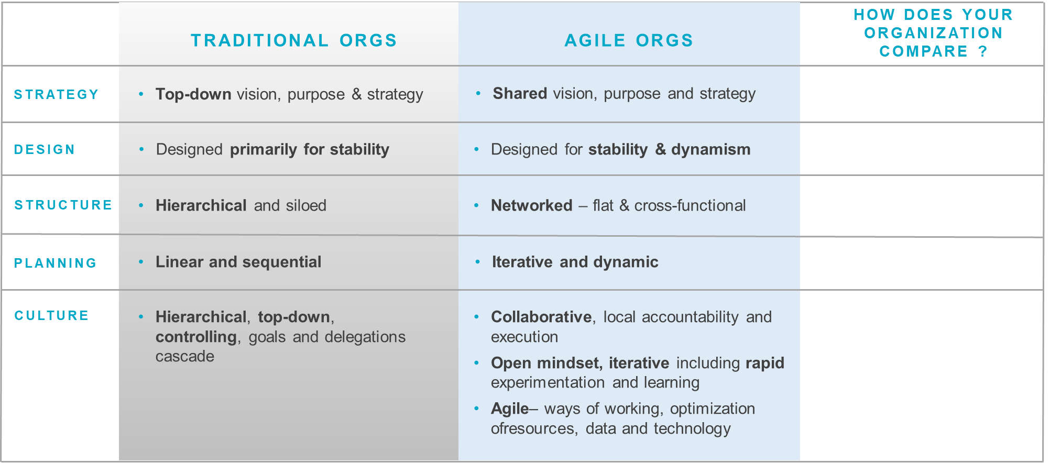
Traditional v Agile Organizations – how does your organisation compare ? What are the main gaps at a high level ?

