Slide 1
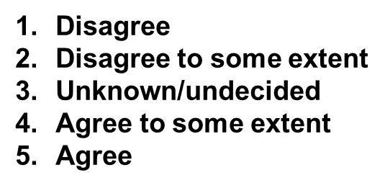
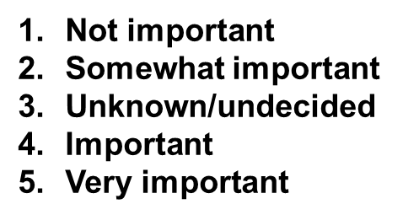
Organizational Agility ‘Heath Check’ – SCOPE (Summary version)
Organizational Agility Category | Organizational Agility Statement | Current State Score | Importance to our business | Gap & Notes
Strategy | Agility and adaptiveness are explicitly called out and expressed as strategic priorities across the organization
 | Agile principles such as customer engagement, flexibility, collaboration, diversity etc. strongly influence our business planning processes.
Culture | We have a culture throughout the organization that is supportive of experimentation, co-creation and innovation for the benefit of our customers
 | Senior Leaders of our organization take accountability, trust employees and enable a safe culture of experimentation & learning by doing, they role model an open and agile mindset
 | Team leaders and people managers encourage an open and safe environment for experimentation, growth & learning by doing
Organization | Our structures, systems and technology enable agile practices and outcomes
 | Our operational processes have the capacity to implement changes quickly and to convert these changes and resources to performance
 | We have agile team structures and processes in place that help us efficiently organize and prioritize our work, share resources and work across team boundaries.
 | Our decision making processes are flexible and can vary depending on the needs of specific initiatives. Decisions are consciously distributed and delegated throughout the organization.
People | Our recruitment and workforce planning processes are designed with having workforce agility and flexibility in mind and our talent strategy supports the development of an agile organization.
 | Our supporting HR processes and policies (e.g. our training, remote working, reward, performance and recognition processes etc.) are recognized as important enablers of workforce and organizational agility.
External Focus | We optimize external partnerships and relationships in our business operating model (e.g. co-creation of value with our suppliers and external partners)
 | Our organisation understands the need and takes steps to deliberately scan the internal & external environment to identify opportunities and risks for our business.

